Slide 1
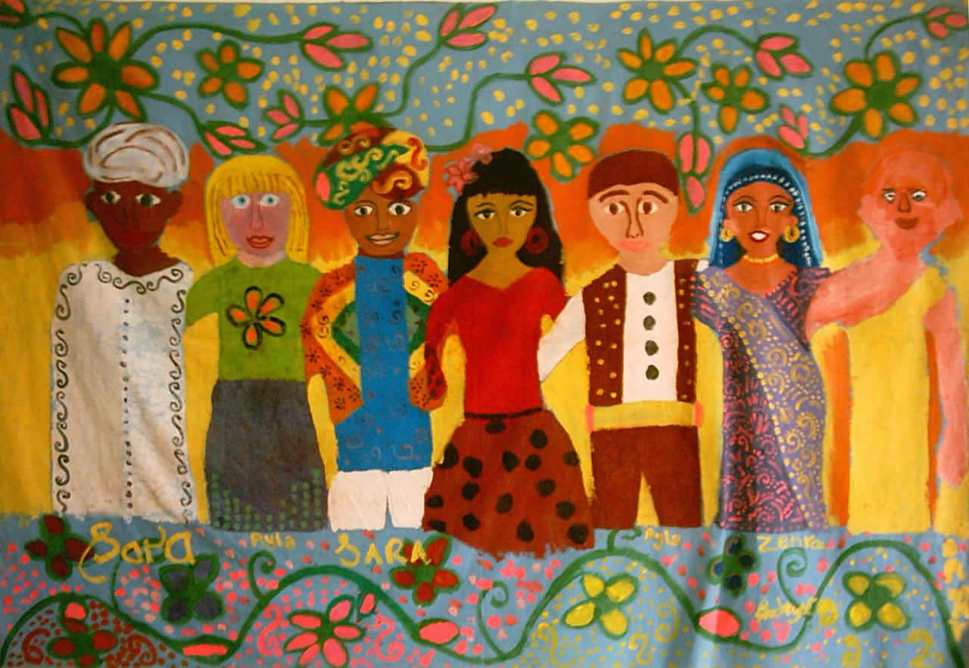
Culture and Heritage
http://rakstagemom.wordpress.com
Notes:
•The U.S. population is becoming more and more culturally and ethnically diverse.
•How we define health and place meaning to illness and treatment is largely influenced by our culture.
•To care for people holistically, nurses need to integrate culturally congruent care within their nursing practice.

Slide 2
What is culture?
Take a moment to think about how you would define “culture.”
Notes:
We talk a lot about culture, and the influence culture has on our health, our relationships with others (including patients), and is a part of our own identity. But, how would you define culture? Think for a moment and write down a few words to bring meaning to the term.
Share: What did you write?

Slide 3
What is culture?
Defined in various ways by different disciplines and for numerous purposes
Culture can be broadly seen as a common heritage or set of beliefs, norms, and values.
Non-physical traits, such as values, beliefs, attitudes, and customs, that are shared by a group of people and passed from one generation to the next.
Shared, and largely learned, attributes of a group of people
Culture is a system of shared meanings.
Notes:
As you eloquently described, culture can be defined in various ways by different people, depending on the purpose of the definition.
Culture can be broadly…….
Examples---read.

Slide 4
Why is culture important?
American society is becoming increasingly diversified. American's modern family
Dramatic changes in our nation’s ethnic composition is changing the way we think about ourselves.
Culture influences most, if not all, aspects of human and social interactions.
Culture plays a pivotal role in health, illness and healthcare services.

Slide 5
Seeing culture
Culture is omnipresent and frequently invisible, especially to those enmeshed within a particular culture.
Since one is born into a culture, one experiences that culture as “the way it is” not as just “one way to see the world”
Notes:
Read—point 1—culture is omnipresent and frequently invisible—especially to those enmeshed within a particular culture. Kind of like a fish in a fishbowl.
Since one is born into a culture, we experience that culture as the way it is, not just ONE way to see the world.
It is only when we encounter people who differ from us, that we “see” our differences. Examples, being the new kid in school, moving to a different country, or a fish out of water! These experiences help us get in touch with those characteristics, beliefs and values that are truly our own culture.
How we see others is largely influenced by our own culture and life experiences—in other words, we see others through the lens of our own culture, experiences and values.
Getting in touch with our own culture helps us to “see” the lens through which we see and interpret others. Being culturally competent is to not let our own culture cloud our vision of others, but to be open to understand and support another’s culture.

Slide 6
Common variations related to culture
Clothing
Music
Religion
Food
Family life
Language
Sexuality
Child rearing
Family patterns
Children and elders
Extended family
Family and given names
Communication style
Verbal language
Non-verbal language
Space orientation
Time orientation
Nutritional patterns
Notes:
The behaviors and characteristics that have cultural origins are vast—how we dress, what we eat, our language, and how wee interact with one another are rooted within our culture and family structures. Differences affect our relationships across cultures. Let’s consider a few of these variations—
What can you tell me about some differences you know about in relation to these characteristics?
Examples:
Gestures: Come here vs. extending arm; thumbs up in Western societies vs. Greek; “OK” in Russia or Turkey—sexual insult
Eye contact: may be considered rude or an invitation??
Physical contact—are you a “touch” person? How might that be perceived by other cultures?
Calling baby “cute” Hmong and Vietnamese—fear comments may be overheard by spirit that will try to steal or harm baby
How about perception of time—what does it mean to you when someone is late to an appointment?
The list of culturally unacceptable behaviors is long and varies according to culture. Navigating our own behaviors in cross-cultural situations can be sticky, at best!

Slide 7
Health Beliefs and Practices
Culture-bound disorders and syndromes
Health decision-making within families
Birthing traditions
Sharing of health information
Traditional healers and practices
Credibility of healthcare providers and systems
Notes:
With all the cultural variations in how we live and relate to one another, it should come as no surprise that our culture also influences our thoughts and behaviors around health, illness and healthcare practices.
In fact, there are a number of our western disease labels that have no translation into other languages, and some disorders which are described in other cultures have no translation into western language or medical practice. These are considered ‘culturally bound” disorders.
Culture plays a key role in how health decisions are made within a family—who makes the decisions, who should be contacted first about a serious health condition—all may vary by culture.
The traditions, precautions and perceptions around pregnancy, delivery and the care of infants and children are steeped in culture—just as are traditions and beliefs around death and dying.
Traditional beliefs and healing practices across the globe are abundant—their place within our western model of healthcare is often questioned, and rarely supported financially.
Lastly, how we as healthcare providers and healthcare systems (such as hospitals) are perceived is influenced not only by our current interactions with our patients, but is highly influenced by other’s culture and history. Consider the impact of historical racism on African American’s trust in the medical community—what happened in Tuskegee decades ago may still be a factor in whether or not an individual will trust and follow medical advise.

Slide 8
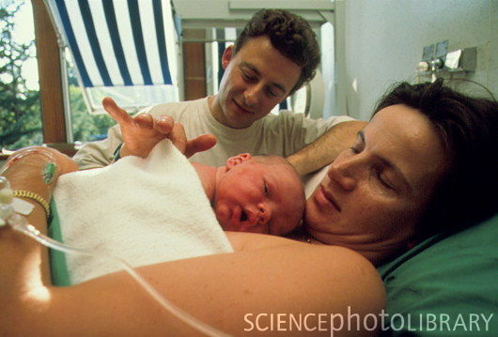
Individualism and Collectivism
Although people in a particular culture are likely to have commonalities…
There is also variation across situations and across individuals within a particular group.
Important not to make assumptions based on your own culture or your assessment of their cultural group.
Notes:
There are just as many traditions and beliefs in the world as there are different groups of people.
As nurses, it is important to learn about other cultures, but we must be cautious not to place someone in a “box” based on what we learn—sometimes there are more differences within a group than between groups.
It is important not to make assumptions based on our own culture (that lens again), or our assessment of the other person’s cultural group (Collectivism)—an example may be that because you are Chinese, you use acupuncture.
Considering individual beliefs and practices in caring for others is considered Individualism.

Slide 9
Self-Assessment
Notes:
The first step in becoming culturally competent is to become aware of our own culture—who we are influences how we see and accept others. Now that we have talked a little bit about what culture is, let’s do a little exercise:
Take a moment to write down a few words or phrases to describe YOUR culture.
Circle those words and phrases that are typically included in a hospital admit note or progress note.
If healthcare providers focus their care around only these factors, what important beliefs, values, and customs would they miss about you? What difference would that make in your care and your health?

Slide 10
Cultural Nursing Care
Culturally sensitive
Basic knowledge of cultures within his or her practice setting
Culturally appropriate
Applies that knowledge to provide care
Cultural competency in nursing
A defined set of values and principles, and demonstrated behaviors, attitudes, policies and structures that enable nurses to work effectively cross-culturally.
Notes:
The foundation of transcultural care is to first identify our own beliefs, culture, and experiences, for they become the lens through which all others are perceived.
Compare your personal beliefs and practices with those held by people from a different ethnic or cultural background.
Identify how the “dynamics of differences” may influence your nursing practice.
Some of the terms we use when describing cultural nursing care….

Slide 11
Culturally Competent Nursing
Value diversity
Have the capacity for cultural self-awareness
Be conscious of the dynamics of differences
Learn the rituals, customs, and practices of the major cultural groups served
Develop adaptations to diversity and the cultural context of the communities served
Notes:
Culturally-competent nurses….

Slide 12
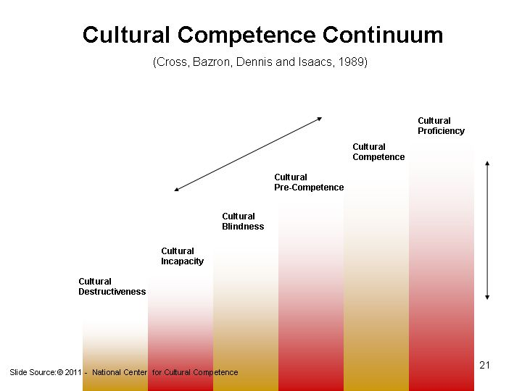
Notes:
Cultural competency exists along a continuum—it is not a light switch that can be turned on or off—but is a continual journey of self-exploration and the process of inquiry to broaden a pool of understanding of individuals and groups.
The continuum can range from cultural destructiveness to competency, and our level may vary depending on the setting, the individual or population group, and the situation.

Slide 13
Cultural Destructiveness | Refusal to acknowledge the presence or importance of cultural differences; Differences are punished and suppressed; universality is practiced.
Cultural Incapacity | The individual or organization chooses to ignore cultural differences; No attention is devoted to supporting cultural differences; Emphasis may be on the disease focus versus addressing the issues of cultural awareness.
Cultural Blindness | Individuals and organizations believe that cultural differences are of little importance; People are viewed through a western cultural mainstream lens; Messages are communicated to others that their culture is of little consequence to the healthcare experience.
Cultural Pre-Competence | The individual or organization recognizes and responds to cultural differences; There is an open acknowledgement of the need for cultural competence; Health care providers may seek out new information regarding diversity by attending training sessions or interacting with those individuals who have insider cultural information.
Cultural Competence | The individual and organization value and appreciate cultural differences; Exploration of issues related to equity, cultural history, knowledge, and social justice; Patients’ cultural experiences are valued and integrated into the healthcare plan.

Slide 14
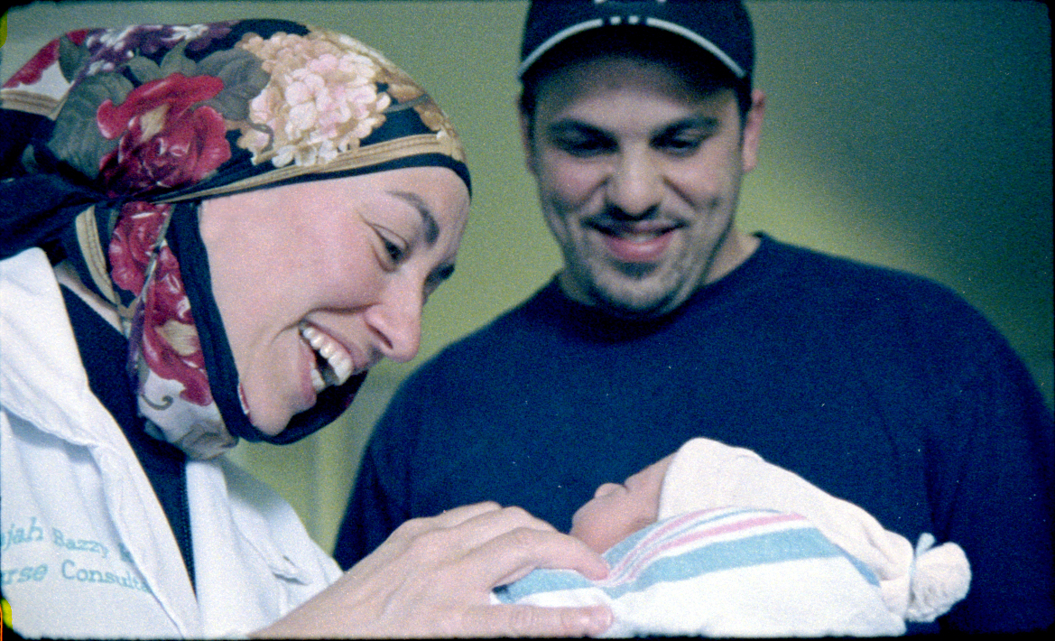
Assessing Cultural Competence
Georgetown University Center for Child and Human Development
Cultural Competence Health Practitioner Assessment
Organizational Self-Assessment

Slide 15
Concepts related to culture
Definition | Term
The state of being different | Diversity
A process when people adapt to or borrow traits from another culture | Acculturation
A process by which an individual develops a new cultural identity | Assimilation
The socially constructed classification of people based on biological characteristics | Race
Preconceived opinion not based on reason or experience | Prejudice
An assumption of similarities among members of a group | Stereotype
A belief that one’s own culture or way of life is better than that of others | Ethnocentric
Differential treatment based on categories | Discrimination
Transition from one culture to another | Culture Shock
Notes:
Reference—understanding these terms and how they are defined by individuals within your team are important conversations. Note: This can be a matching activity for students working in small groups—match the term with the definition.

Slide 16
Health beliefs and practices
Magico-religious health belief
Health and illness controlled by supernatural forces
Biomedical health belief
Health and illness are biochemical processes that can be controlled by human manipulation
Holistic health belief
Forces of nature must be maintained in balance or harmony
Folk medicine
Healing is based on cultural tradition rather than modern scientific basis
Notes:
Culture plays a key role in how we think about our health and health care. What keeps us healthy? What meaning do we ascribe to various conditions? Why do we think they happen to us? What treatments do we think will work in treating our ailments?
Here’s a question—when you were a young child, and had a bad cold, what did your mother (grandmother, caregiver) give you?
The various health beliefs and practices may have grounded in religious beliefs, biomedical beliefs, holistic beliefs and folk traditions and treatments.
Examples of health beliefs and practices is provided as handout. Reference: Clark, M. J. (2008). Community Health Nursing: Advocacy for Population Health (Appendix B: Cultural Influences on Health and Health-Related Behaviors). Upper Saddle River, NJ: Pearson Prentice Hall.
It’s not which belief is “right” or “wrong”, it is what the client and family believes and how we as healthcare providers react to and support their beliefs and practices that comprises cultural competence.

Slide 17
Cultural Competence in Healthcare
National Center for Cultural Competency--Georgetown University
Notes:
So why is cultural competence important?
Yes, we already talked about the increasing diversity of our nation, but why else?
One of the important issues facing our world today is the wide disparities in health outcomes among populations—
Infant mortality
Diabetes
Heart disease
Poverty
Cancer
The National Center for Cultural Competency at Georgetown University is an excellent resource for individual and organizational assessment of cultural competency, training and other resources for health professionals. Here is a quick video from the NCCC called, Cultural Competence for Healthcare Providers (9:27)

Slide 18
Cross-cultural communication
When taking a medical history from a patient with a limited ability to speak English, which of the following is least useful?
a. Asking questions that require the patient to give a simple "yes" or "no" answer, such as "Do you have trouble breathing?" or "Does your knee hurt?"
b. Encouraging the patient to give a description of her/his medical situation and beliefs about health and illness.
c. Asking the patient whether he or she would like to have a qualified interpreter for the medical visit.
d. Asking the patient questions such as "How has your condition changed over the past two days?" or "What makes your condition get better or worse?"
http://erc.msh.org/aapi/tt1.html
Notes:
The first step in the nursing process is Assessment. Often the nurse’s first task is to complete an intake assessment:
When working with patients from different cultures, obtaining the information you need to make a diagnosis and recommend a successful treatment plan can be very challenging. Complete and accurate information is essential since providers are more likely to miss a diagnosis when the medical history is incomplete. It is also important to understand the patient's perception of the illness, in order to develop common expectations of the treatment course and outcomes. There are several useful techniques that providers can use to elicit the patients perspective on his or her illness. It is important that such techniques do not bias the patient's response toward what the provider expects to hear.
Ask Question in slide:
Response: a--While it may seem easier to ask questions that require a simple "yes" or "no" answer, this technique seriously limits the ability of the patient to communicate information that may be essential for an accurate history and diagnosis. Further, the patient may answer "yes" or "no" without really understanding the question. The most effective way to put the patient at ease and to ensure that the patient provides essential information about his or her symptoms is to combine two types of questions: 1) open-ended questions, such as "What can you tell me about the pain in your knee?" and 2) more directed questions, such as "What makes the pain get better or worse?" Always get a qualified interpreter whenever possible.

Slide 19
A Collision of Two Cultures
Hmong child with seizure disorder
Cultural meaning of disease and treatment
“Non-compliance” with medical treatment
Story of a family’s love and culture
Notes:
I want to share a Summer Reading Recommendation that brings to life a real story of a Hmong family in California and their experience with the healthcare system surrounding their daughter’s intractable seizure disorder. The book details the family’s journey in the treatment of their daughter Lia Lee. Lia’s parents fled their mountain village after Laos fell to the communists in 1975. After years in Thai refugee camps, they were resettled in Merced, California in 1980.
Lia was born in 1982, and shortly after had her first seizure. Her family’s struggles with hospitals, doctors and social workers is chronicled in this book. Because of language and cultural differences, her family had trouble administering her medication, and she spent a year in foster care.
The day before Thanksgiving in 1996, she suffered her near-fatal seizure, and was rushed to the Merced hospital for the 16th time. This time, her seizure lasted over two hours. She was transferred to a hospital in Fresno, where doctors declared her brain dead. Her parents brought her home from the hospital to die. But when they removed her feeding tube, Lia’s cries convinced them that Lia was not ready to die. Her parents, like most traditional Hmong, believe in ancestor spirits. They asked a shaman to travel to the highest level in the spirit world and strike a bargain: Give us our daughter’s life and we’ll give you a life in exchange.” They sacrificed a pig and got their wish.
Lia, who in July celebrated her 30th birthday, still living at home and cared for by her mother, brother, seven sisters and numerous nieces, nephews and cousins—died August 31 after lifelong battle against epilepsy, cerebral palsy, pneumonia and sepsis.
The doctors who treated Lia say the book (and her journey) is a game changer– She altered many people’s approaches to dealing with patients with different beliefs.

Slide 20
Kleinman’s Eight Questions
What do you call your illness? What name does it have?
What do you think has caused the illness?
Why and when did it start?
What do you think the illness does? How does it work?
How severe is it? Will it have a short or long course?
What kind of treatment do you think the person should receive? What are the most important results you hope she receives from this treatment?
What are the chief problems the illness has caused?
What do you fear most about the illness?
Fadimen (1997)
Notes:
Some of the lessons learned through experiences like Lia’s led Arthur Klienman, a Harvard Medical School department chair—to develop a list of questions that are now part of almost every discussion of cross-cultural medicine. These questions may open the discovery of cultural meaning of disorders, and help navigate the management of care across cultural divides.

Slide 21
Linguistic Competency
The capacity to communicate effectively, and convey information in a manner that is easily understood by diverse groups including:
persons of limited English proficiency,
those who have low literacy skills or are not literate,
individuals with disabilities, and
those who are deaf or hard of hearing.
Office of Minority Health CLAS Standards
Notes:
We’ve talked a lot about cultural competency, but I want to spend some time on Linguistic competency, which is defined as….
The National Standards on Culturally and Linguistically Appropriate Services (CLAS), published through the office of minority health
The CLAS standards are primarily directed at health care organizations; however, individual providers are also encouraged to use the standards to make their practices more culturally and linguistically accessible. The principles and activities of culturally and linguistically appropriate services should be integrated throughout an organization and undertaken in partnership with the communities being served.
The 14 standards are organized by themes: Culturally Competent Care (Standards 1-3), Language Access Services (Standards 4-7), and Organizational Supports for Cultural Competence (Standards 8-14). Within this framework, there are three types of standards of varying stringency: mandates, guidelines, and recommendations as follows:
CLAS mandates are current Federal requirements for all recipients of Federal funds (Standards 4, 5, 6, and 7).
CLAS guidelines are activities recommended by OMH for adoption as mandates by Federal, State, and national accrediting agencies (Standards 1, 2, 3, 8, 9, 10, 11, 12, and 13).
CLAS recommendations are suggested by OMH for voluntary adoption by health care organizations (Standard 14).

Slide 22
Core Practice Competencies
Include cultural assessment of the client and family
Determine primary language, health literacy and English fluency
Address clients, colleagues by their last names until they give you permission to use other names
Learn the rituals, customs, and practices of the major cultural groups—be authentic and honest about knowledge of their culture
Don’t make assumptions about beliefs or practices

Slide 23
Core Practice Competencies
Ask about the client’s use of cultural or alternative approaches to healing
Identify your personal biases, attitudes, prejudices, and stereotypes
Recognize that it is the client’s (or family’s) right to make their own health care choices
Convey respect and cooperate with traditional helpers and caregivers

Slide 24
For more information
National Center for Cultural Competence
Office of Minority Health
Smithsonian: The Changing Demographics of America
Census Scope 2010 Demographics
Grey's Anatomy--Hmong traditions
Diversity Rx
National Center for Complementary and Alternative Medicine
Cultural Cues
Medical Spanish for Healthcare Providers
Notes:
Resources:
Post links to the websites on the Learning Management System (LMS). List of resources above also have hyperlinks to the websites listed.
In class, the video link to “Grey’s Anatomy” is shown (6:28), with class discussion on the actions of the health providers regarding the patient’s Hmong beliefs and how culture affects healthcare decisions within families.

